Slide 1
Image Search tool
On Flickr Images
By Harinarayanan N.R

Slide 2
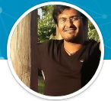
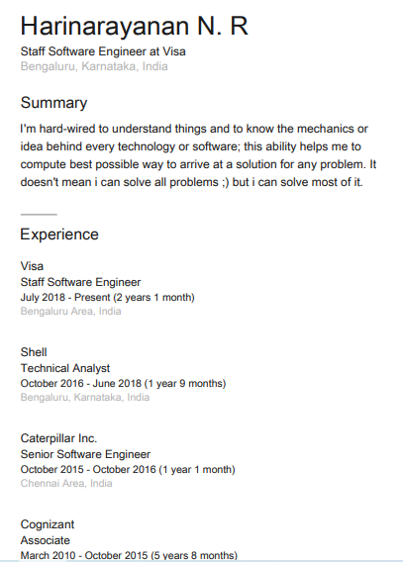

About Me
I'm hard-wired to understand things and to know the mechanics or idea behind every technology or software; this ability helps me to compute best possible way to arrive at a solution for any problem. It doesn't mean i can solve all problems ;) but i can solve most of it.
LinkedIn Profile

Slide 3
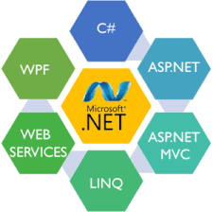
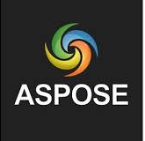
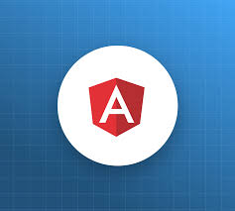
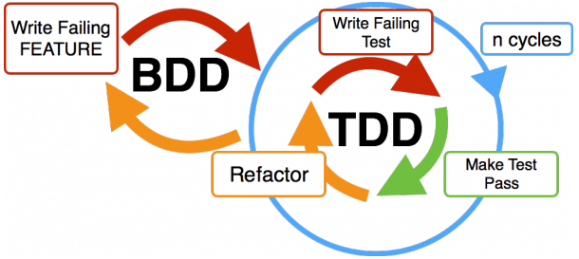






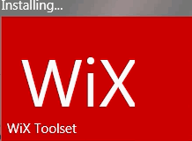


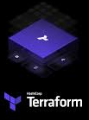

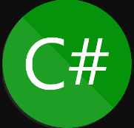

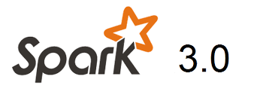
Technology Stack in My Quiver
New Addition

Slide 4
Challenges Faced
Due to Security Udpate in my work laptop, I have to recode the WPF app from scratch .
I have borrow a laptop which is very old didn't have space to install even VS code.
I have rewrriten the code using notepad++ and compile the code using .net core 3.1 cli.
So I have done the bare minimun coding that is requirde.

Slide 5
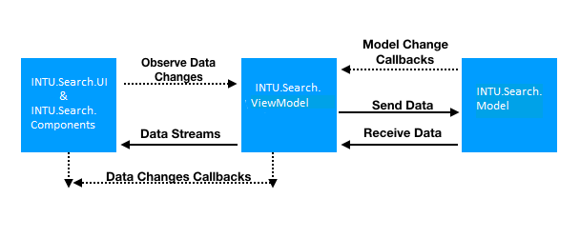
Description
I have use MVVM architecture an separate UI (Main Layout, Usercontrol Lib),Model ,ViewModel in to different project.
UI Architecture

Slide 6
Description
I have Business layer and Client Layer; in both of these layer I have use pattern like factory for params and client object generation
Backend Architecture

Slide 7
Backend Architecture Revisit
Initially I thoght of using Factory for client & search parameter class object generation.
Thought of using decorator pattern for adding new & advance search criteria to search param class.
Also thought to implement IView Interface so I can decouple
UI from ViewModel.
Thought of using caliburn.micro package for making MVVM implementation easy an use convention over configuration.
Even thought to implement Statergy pattern for offline search of image in local laptop or Desktop.

Slide 8


Feathers In My Cap
Developed a tool to create POCO Classes from any Database.
Create a library called "hotkey" for navigation using keyboard for web portal.
Used Node webkit to minify and transform web app to standalone app for machine ECU.
Used Infragistics to create CAT customized installer.

Slide 9


Feathers In My Cap
Worked on end to creation of IAAS infra. configure service fabric and create CI/C pipeline and also create microservice an frontend using Angular app..
Used R to create dynamic analytic charts and integrated it with scorecards angular app.
Used superset for giving users ability to create dashboard.
Created performant ETL pipeline using Apache NiFi and create plugins for it.
Used Terraform for codify infrastructure and application packaging an deployment.

